Slide 1
HLD e LLD – Oak Truffle

Slide 2
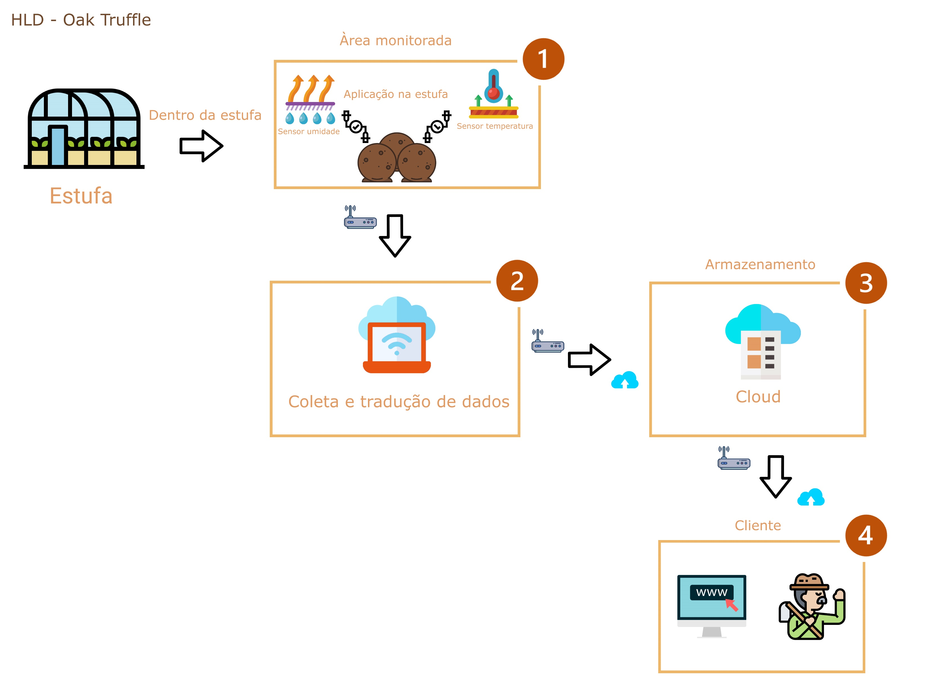
High level design

Slide 3
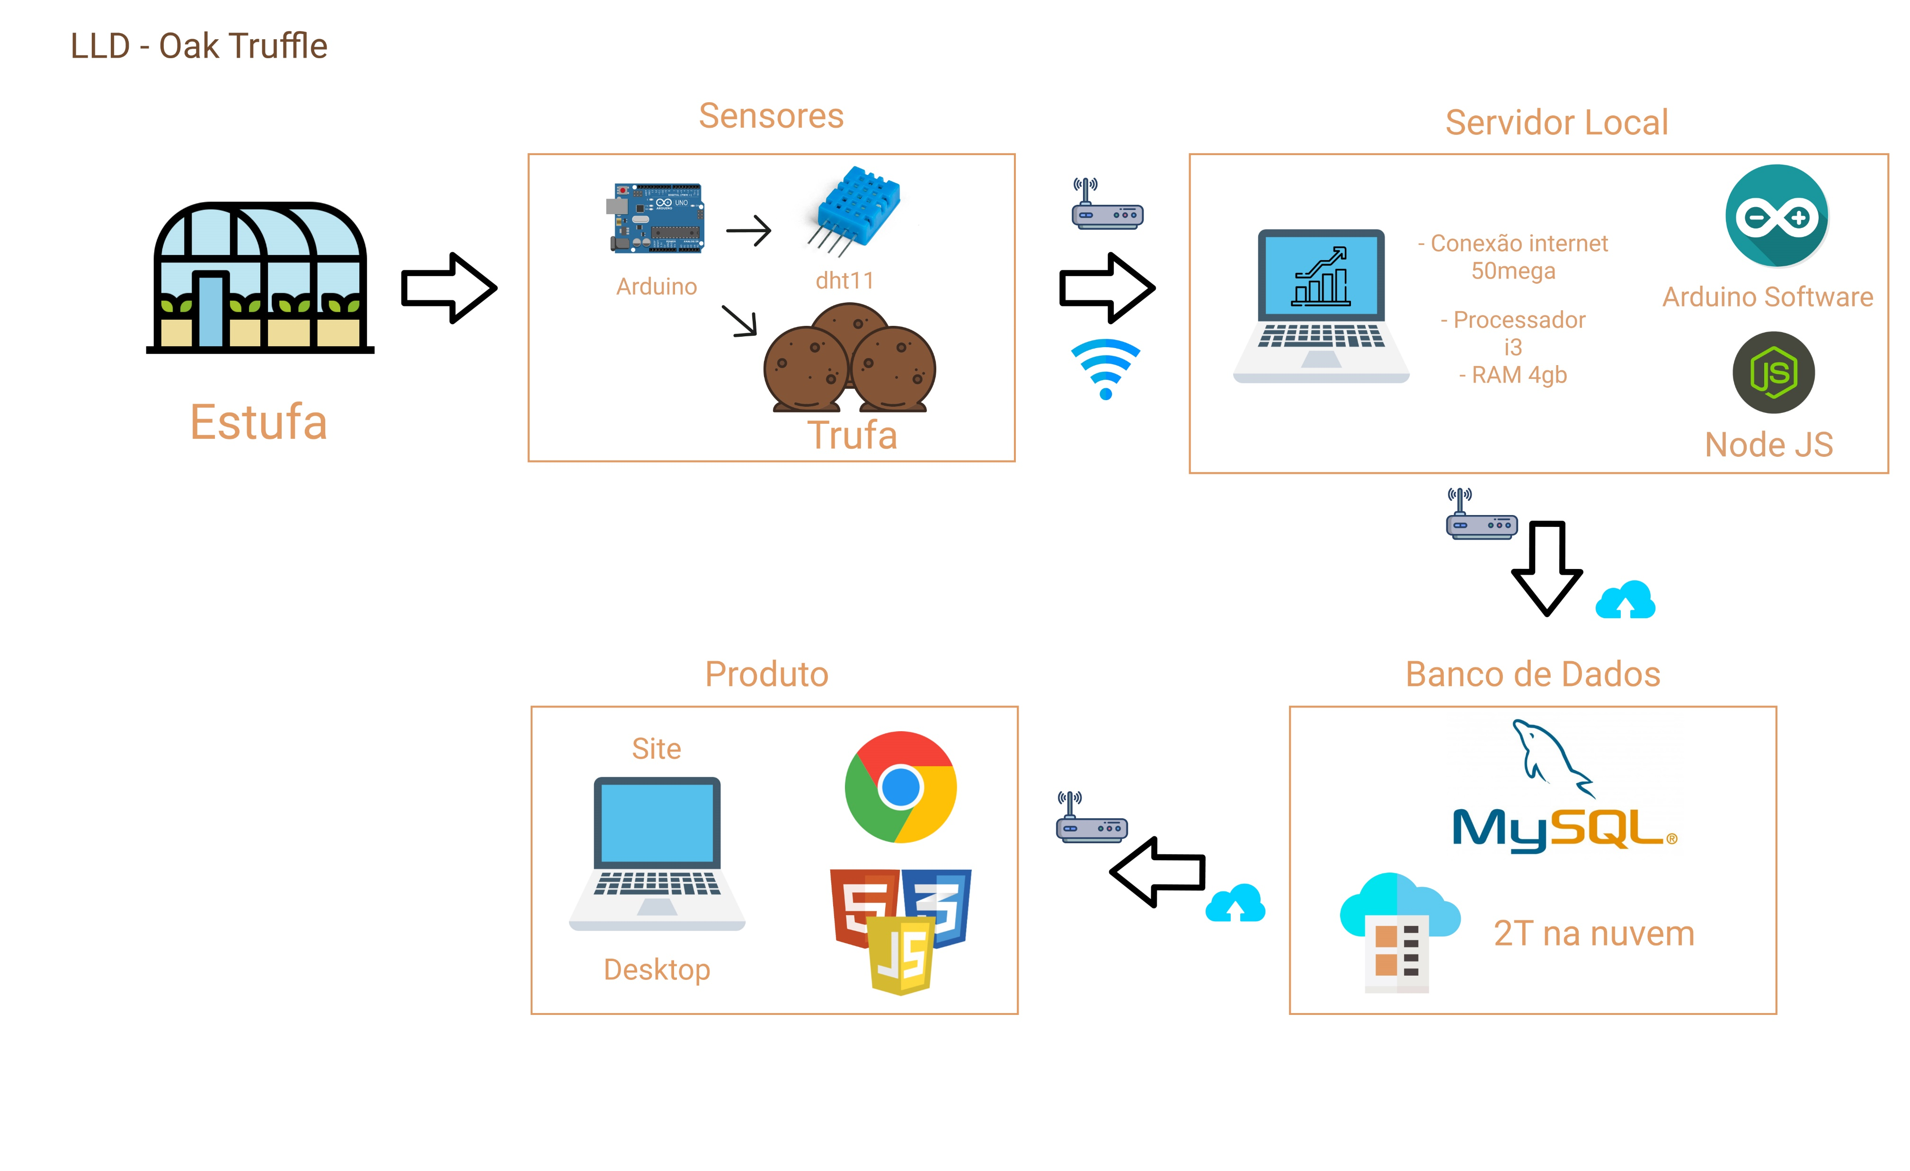
Low level design

